Slide 1
Lecture 7 Introduction to Machine Learning ⇨ Low-Dimensional Embedding
(LDE)
András Lőrincz
Department of Artificial Intelligence
Faculty of Informatics

Slide 2
CONTENT
Plan New Plan
1. Introduction
2. Cognition, IQ and making sense
3. Key problems of AI and human intelligence
4. Goal oriented systems
5. Classical AI versus learning from examples: how to combine them?
6. Image and video processing
Mid-term exam (October 21, 2020)
7. Speech processing, natural language processing
8. Behavior characterization and situation understanding
9. Explainability (XAI) for human understanding, information fusion and distributed intelligence
10. Human-machine interaction, „Edge TPUs”, and distributed intelligence
11. Control, influencing, fake information, legal and ethical issues,
12. Summary: Artificial General Intelligence
➔ Final exam
1. Introduction
2. Cognition, IQ and making sense
3. Key problems of AI and human intelligence
4. Goal oriented systems
5. Image and video processing
Mid-term exam (October 21, 2020)
6. Speech processing, natural language processing
7. Embedding and visualization for human understanding
8. Control and robots
9. Natural Language Processing and video-grounded NLP
10. Summary: Artificial General Intelligence
➔ Final exam

Slide 3
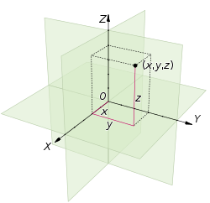
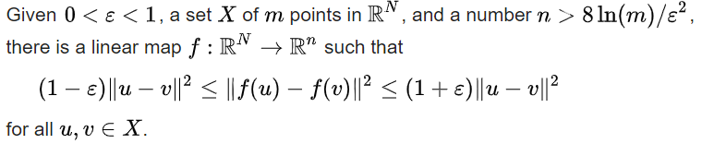

The basis of embedding:
Johnson-Lindenstrauss Lemma
Euclidean space
Real n-space R^{n} equipped with
a dot product $\left(x,y\right)→ \left\langle x,y\right\rangle →x^{T}y$
and thus a norm $\left\|x\right\|:=\sqrt{x^{T}x}>0$
$if x≠0$
and $0$ otherwise
The lemma:
N does not play a role…
only m (the number of samples) plays a role…

Slide 4
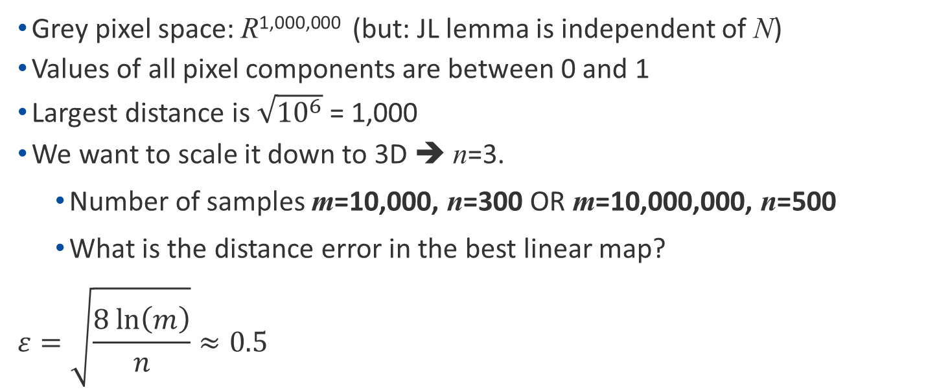
Example: Image
Grey pixel space: R^{1,000,000} (but: JL lemma is independent of N)
Values of all pixel components are between 0 and 1
Largest distance is $\sqrt{{10}^{6}}$ = 1,000
We want to scale it down to 3D ➔ n=3.
Number of samples m=10,000, n=300 OR m=10,000,000, n=500
What is the distance error in the best linear map?
$$ε=\sqrt{\frac{8 \text{ln}\left(m\right)}{n}}≈0.5$$
JL Lemma holds for the general case
➔ Samples of natural signal are, however, special

Slide 5
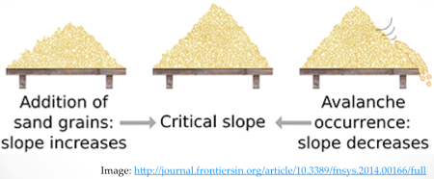
JL Lemma is valid for most data in nature
We don’t have time to discuss this further
Highlights:
The key concept is „sustained system”:
Nature is a so called „sustained system”
It is sustained by the energy inflow from the sun
Sandpile is similar. In the example, it is sustained by us
Stock market is similar. It is sustained by innovation and manpower
„Avalanches” appear in sustained systems and – typically – show heavy-tailed (1/f) distributions
1/f distribution can be compressed more, than Gaussian distribution, since
Gaussian distribution can’t be compressed at all
JL Lemma is general and holds for Gaussian distrubutions, too
Lower dimensions should be achieved for signals in Nature
Some datasets can be compressed much better
The specific nature of natural phenomena
Self-organized criticality
1/f noise (fractal geometry, pink noise, power laws)
sandpile model
Non-linear mapping can improve the limit
Non-linear embedding is also called manifold learning
How to find the best dimensions?
Are autoencoders „low-dimensional embedders”?
Some slides from Todd Wittman to follow

Slide 6
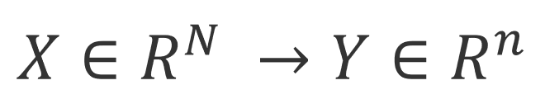
Manifold Learning for Dimensionality Reduction → Low-Dimensional (LD) Embedding (LDE) → The practice of compression in classical ML
Goal: We want to map a N-dimensional dataset X to a n-dimensional data set Y, preserving the local geometries on the original manifold as much as possible.
Classical methods
MDS – multidimensional scaling:
uses distances between datapoints to get the LD coordinates
example: city distances → city coordinates
PCA – principal component analysis: searches for axes of largest STD values
ISOMAP – distances, but not Euclidean distances
LLE – local linear embedding – only local constraints are used
Hessian LLE – a version of LLE
Laplacian Eigenmap – constructs a graph with edges between neighbors
Diffusion Maps – Considers diffusion processes on the graph
KNN Diffusion – Graph is redefined
So which one is the best?
First let’s take some examples...
See: http://people.inf.elte.hu/nipg/ANN_gyak/Others/oraidemok/Manifold_learning/mani_presentation.ppt

Slide 7
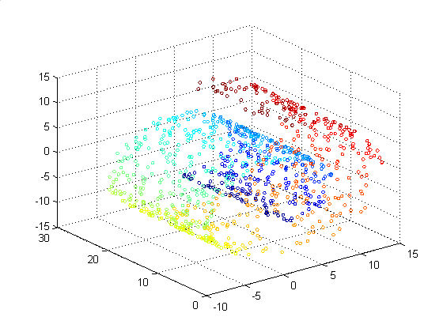
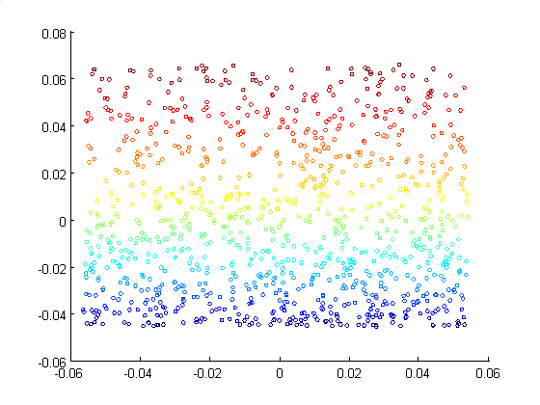
Manifold Geometry
Let’s try to unroll the Swiss Roll.
We should see a plane.

Slide 8
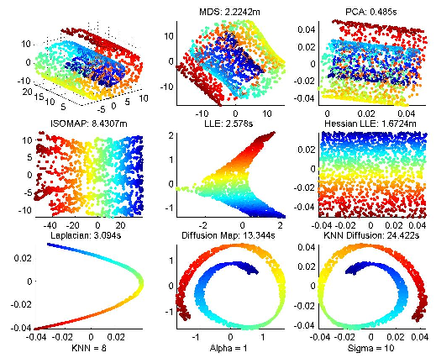
Hessian LLE is pretty slow, MDS is very slow, and ISOMAP is extremely slow.
MDS and PCA can’t unroll Swiss Roll, use no manifold information.
LLE and Laplacian can’t handle this data.
Diffusion Maps could not unroll Swiss Roll for any value of Sigma.

Slide 9
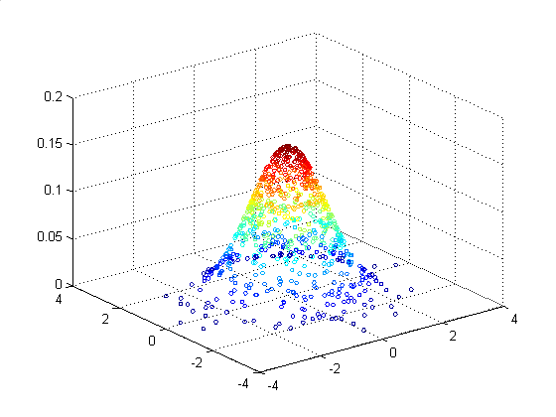
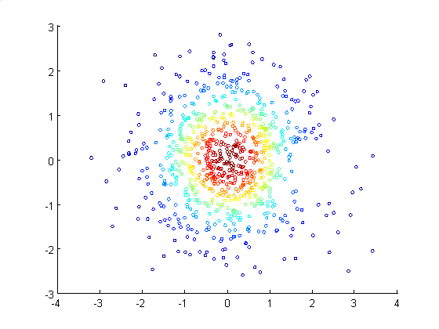
Curvature & Non-uniform Sampling
Gaussian: We can randomly sample a Gaussian distribution.
We increase the curvature by decreasing the standard deviation.
Coloring on the z-axis, we should map to concentric circles.

Slide 10
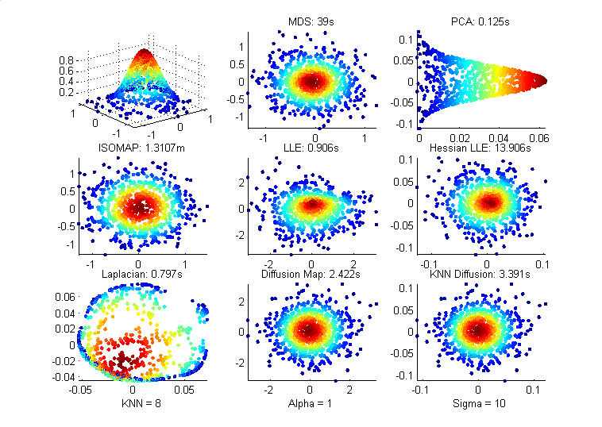
For std = 0.4 (higher curvature), PCA projects from the side rather than top-down.
Laplacian looks even worse.

Slide 11
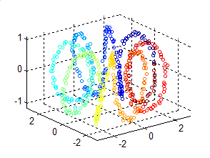
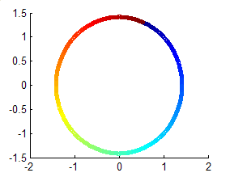
Noise & Non-uniform Sampling
Can the method handle changes from dense to sparse regions?
Toroidal Helix should be unraveled into a circle parametrized by t.
We can change the sampling rate along the helix by changing the exponent R on the parameter t and we can add some noise.

Slide 12
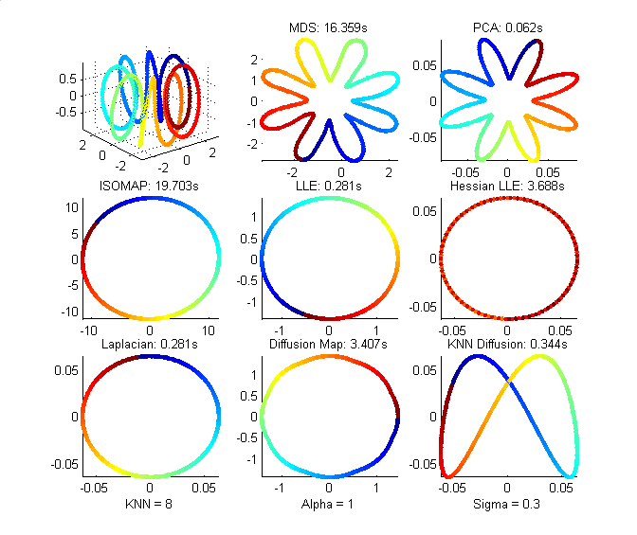
With no noise added, ISOMAP, LLE, Laplacian, and Diffusion Map are correct.
MDS and PCA project to an asterisk.
What’s up with Hessian and KNN Diffusion?

Slide 13
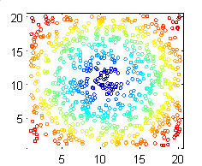
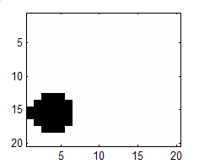
High-Dimensional Data
All of the examples so far have been 3D.
But can the data handle high-dimensional data sets, like images?
Disks: Create 20x20 images with a disk of fixed radius and random center.
We should recover the centers of the circles.

Slide 14
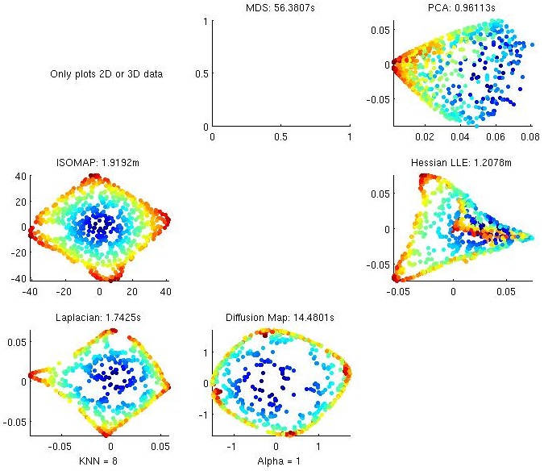

???
LLE
Crashed
LLE crashed on high-dimensional data set.
Number of images was not high enough, but ISOMAP did a very good job.

Slide 15

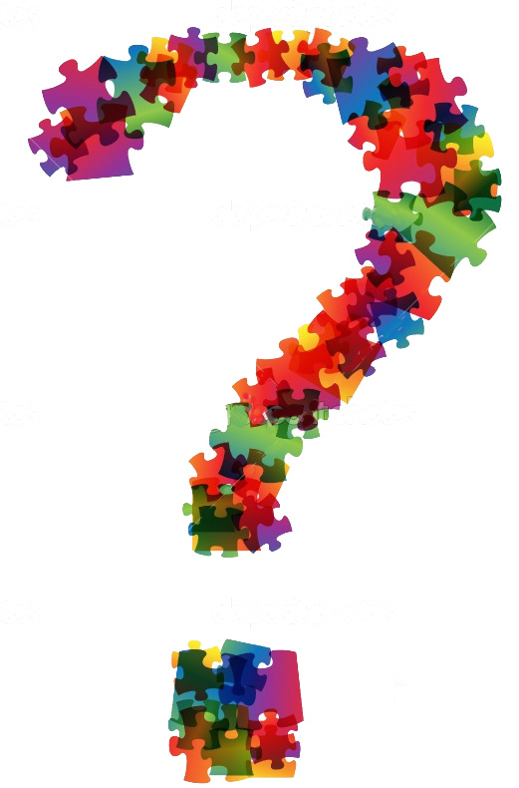

How would you do it with deep learning?

Slide 16
Autoencoder?
The design of the autoencoder learns a "meaningful" representation of the input, preserving its "semantic" features
it holds especially for sparse autoencoders
In 2019 I said, autoencoders cannot preserve distances.
It is true and remains true for sparse autoencoders
BUT
2020: Approximate Geodesics for Deep Generative Models
Metrics for Deep Generative Models (2018)
Learning Flat Latent Manifolds with Variational AutoEncoders (2020)
The latent (hidden variable) space is constrained into a lower dimensional space that tries to save the distances between the samples
Precise metric generation/learning becomes possible
Both sparse and dense autoencoders are needed – simultaneously:
sparse for eXplainability (Occam’s razor – slide 13, Lecture 2)
dense for metric and path planning, i.e., for control in the latent space

Slide 17
Embedding in effect:
NIPGBoard – for human-human collaboration
Original softwer: Google. https://projector.tensorflow.org/
Modification for interaction: http://nipg14.inf.elte.hu:6006/#projector
The method:
Use one of the deep clustering methods in NIPGboard
Click on similar samples for each class
n click / class ➔ n(n-1)/2 Connected Samples (SC)
Train with a Similarity Based Deep Clustering method (SBDC)
Click on a pair of dissimilar class members
2 click to clusters with n and m members ➔ nm CS
Train with SBDC
Continue until satisfaction
No satisfaction ➔ go back to the AI expert and show the results

Slide 18
This
is the
END!
BUT go further
for homeworks and
for the questions!
lorincz@inf.elte.hu

Slide 19
Questions
What is the goal of low-dimensional embedding?
What are the advantages of dense embedding as opposed to sparse compression?
What kind of distributions can be expected in Nature?
What is the key thought in low-dimensional embedding?
What is a sustained system?

